Slide 1
Exquisite Bodies
interactive exquisite corpse

Slide 2
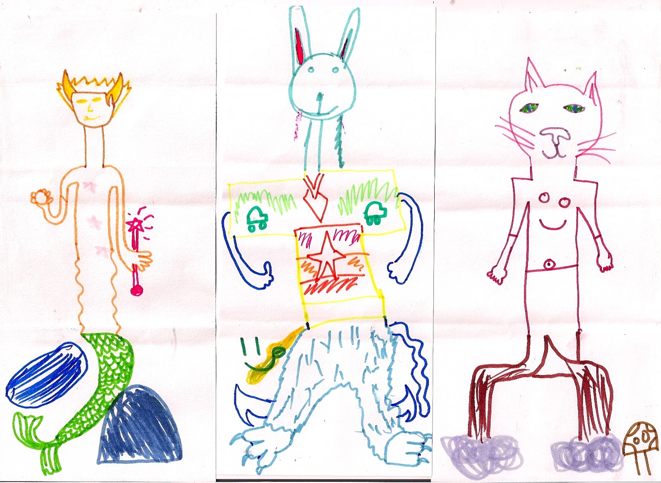
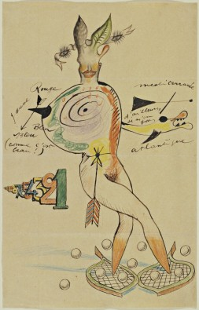
Sources & Inspiration
My inspiration for this work largely comes from making and drawing “exquisite corpses” with friends when I was younger. Learning to Mix and matching things to make something new or simply to create a new point of inspiration. Discovery, one of many recurring themes in my creative developments makes up the core of this exploration.
Artists have been playing on this theme for a long.. Long time.
Nude
Cadavre Exquis with Yves Tanguy, Joan Miró, Max Morise, Man Ray (Emmanuel Radnitzky)
(French)
https://www.moma.org/learn/moma_learning/max-ernst-levade-the-fugitive
Child drawn “exquisite corps” parlor game style.
http://exquisiteme2012.blogspot.ca/2012/05/ardeer-primary-school-exquisite-corpse.html

Slide 3
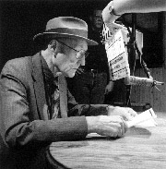
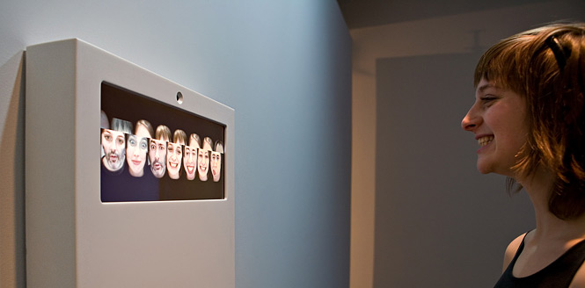
Similar Works
The “Cut-Up” Technique
William S Burroughs looking over his cut-ups.
http://www.languageisavirus.com/articles/articles.php?subaction=showcomments&id=1099111044#.WJApF4VhqQs
Reface [Portrait Sequencer] by Golan Levin and Zachary Lieberman A surreal video mash-up, composes endless combinations visitors' faces.
http://www.flong.com/projects/reface/

Slide 4
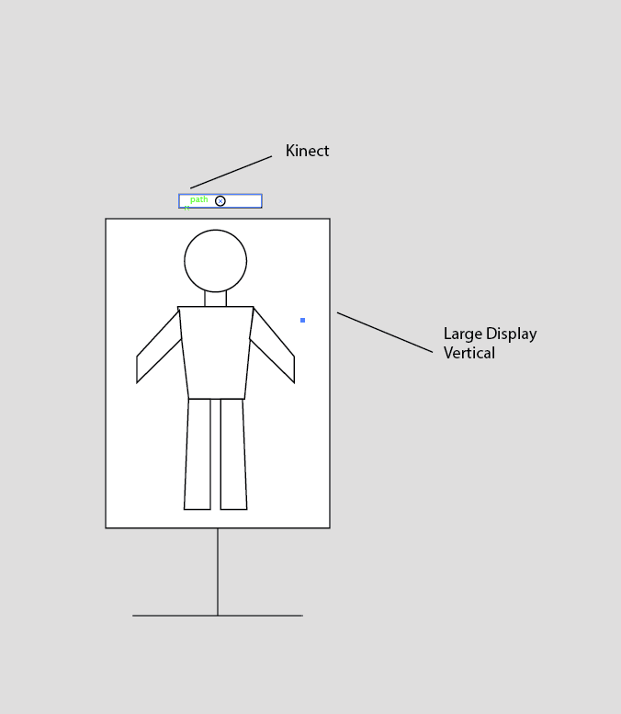
What is it?
Exquisite Bodies is an interactive photo booth that mixes-n-matches body part images into new characters that the user engages with.
Using a large display, a computer running processing and one kinect v2 camera, the idea is to capture an image and separate parts of the image into 6 groups for real-time reconstruction into new characters.
The user can “teach” the character actions, or it just copies the user’s behaviour.
1
2
3
4
5
6

Slide 5
Project Scope
Get kinect libraries etc up and running
Program masking out users, bodies, and saving images
Explore pixel selection approaches, for parts-making and saving
Explore re-attachment options and methods
De/revise an interaction
Clean up code, use classes properly, comment and credits
Start back at step 1 until perfect or due date.

Slide 6
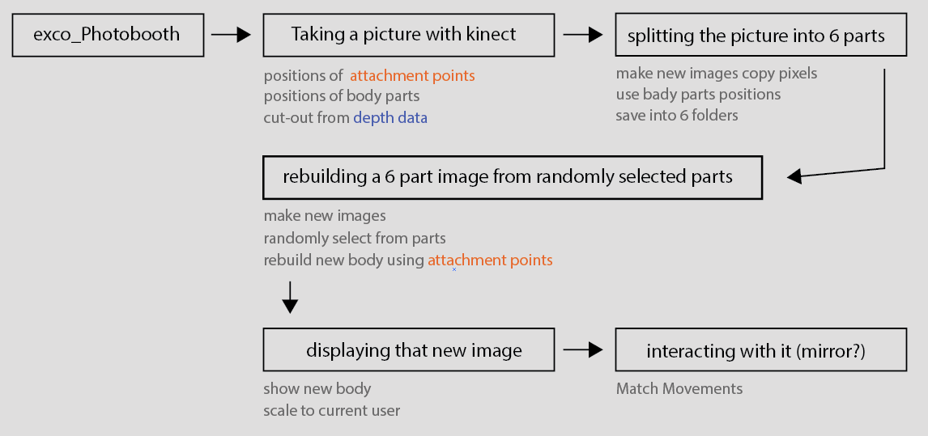
Best Guess

Slide 7
UML class diagram
Class recordPositions
skelData
+keyboardInput()
Class attachmentPoints
skelSnapshot
recordPosition(AttPoints)
Neck, L.shoulder, R.shoulder, L.hip, R.hip
saveData()
Class TakePicture
KinectDepth
SkelData
IdleMode
keyboardInput()
cutoutBackground(KinectDepth)
newRGB() = exCo
newSnapshot(skel.Data)
Class skelSnapshot
ListofVectors
recordPosition(Parts)
Head, Torso, L.arm, R.arm, L.leg, R.leg
saveData()
Class splitBodyToSix
exco image
skelSnapshot
mapSkelSnap_to_pixels()
For each part (6 times)
selectPart()
savePart()
Save into respective groups
Class makeCorpse
Using 6 parts randomly
And referencing attachmentPoints
Create new RGB image
Layer in 6 parts
Cutout-background

